Slide 1
Salary Range Prediction
Name :- Pushpak Shrimal

Slide 2

Salary Range Prediction
In this project, we aim to develop a predictive model for estimating the salary range of job postings. By leveraging a dataset containing various job-related features, we employ machine learning techniques to predict the average salary based on specific job criteria.

Slide 3
Problem Definition
Data Collection
Data Preprocessing
Exploratory Data Analysis (EDA)
Model Building
Model Evaluation
Model Interpretation
Insights and Reporting
Maintenance and Monitoring

Slide 4

INTRODUCTION
This project focuses on predicting average salaries for job postings by analyzing features like job ID, number of positions, and salary ranges. By using machine learning techniques, we aim to provide insights into salary trends and key factors that influence salaries. Our goal is to support HR departments and job seekers in making informed decisions about salary expectations and job applications.

Slide 5
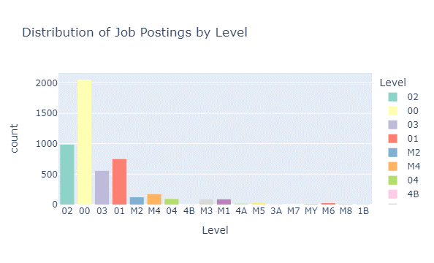
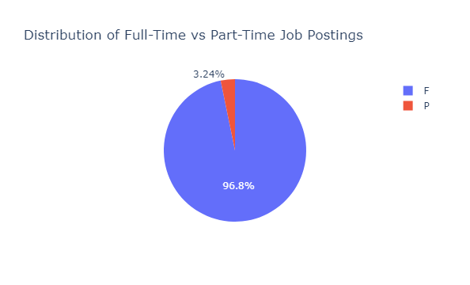
Exploratory Data Analysis (EDA)
EDA Process for Salary Range Prediction
Data Inspection: Reviewed dataset features such as job ID, number of positions, salary ranges, and agency details.
Handling Missing Values: Identified and resolved missing data for completeness.
Categorical Encoding: Converted categorical variables (e.g., agency, job title) to numerical using one-hot encoding.
Distribution Analysis: Analyzed numerical feature distributions to understand their spread.
Correlation Analysis: Explored feature relationships to identify salary predictors.
Visualization: Used histograms, box plots, and scatter plots to identify patterns and trends.

Slide 6
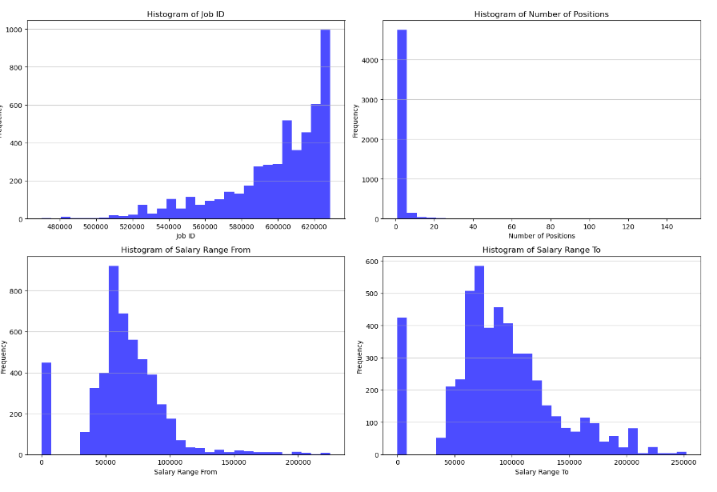
DISTRIBUTION OF NUMERICAL VARIABLE
Interpretation of Histograms
Job ID:
The histogram shows a steady increase in the frequency of job postings with higher job IDs, indicating more recent job postings.
Number of Positions:
The majority of job postings advertise only one position, with very few postings offering multiple positions.
Salary Range From:
Most job postings have a starting salary range clustered around $50,000, with fewer postings offering higher starting salaries.
Salary Range To:
The ending salary range is more spread out, with a peak around $100,000, indicating varied compensation packages across different job postings.

Slide 7
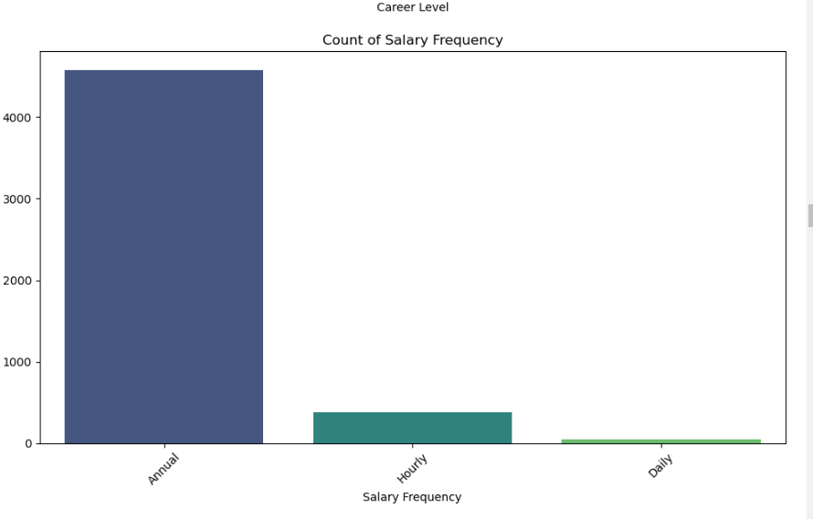
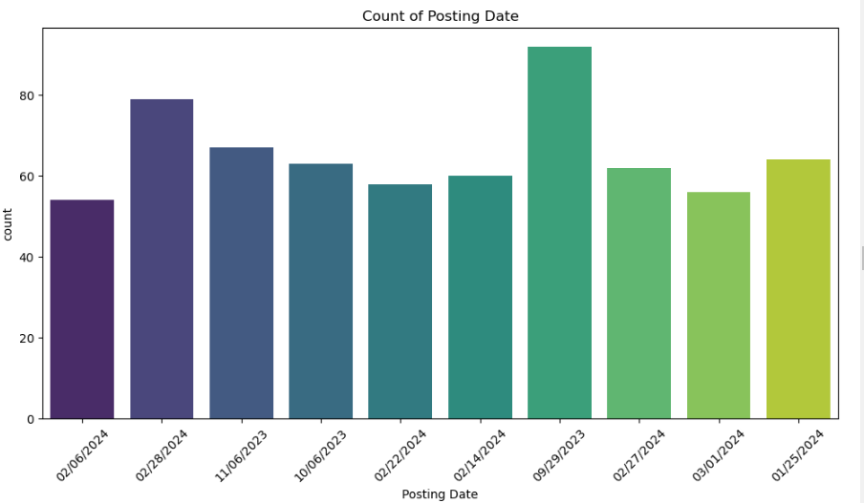
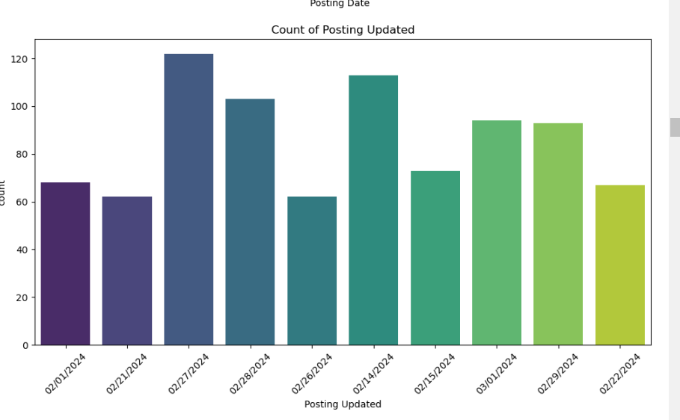
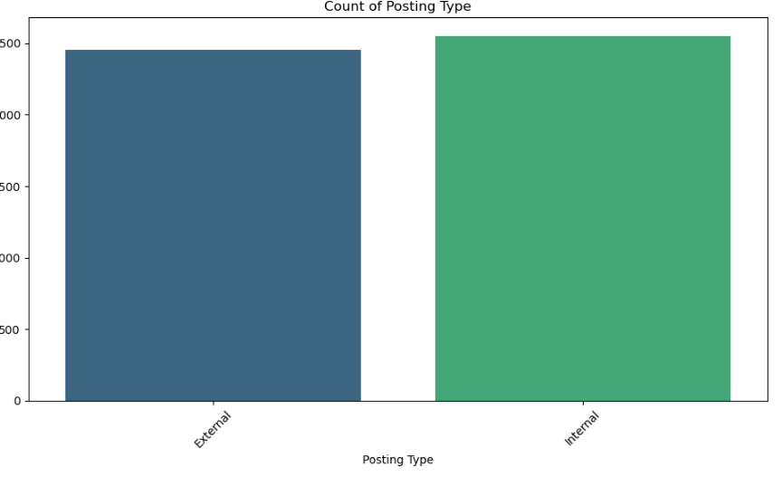
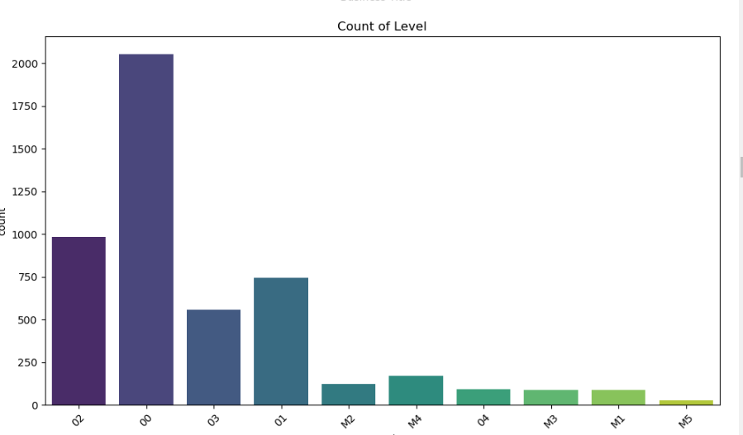
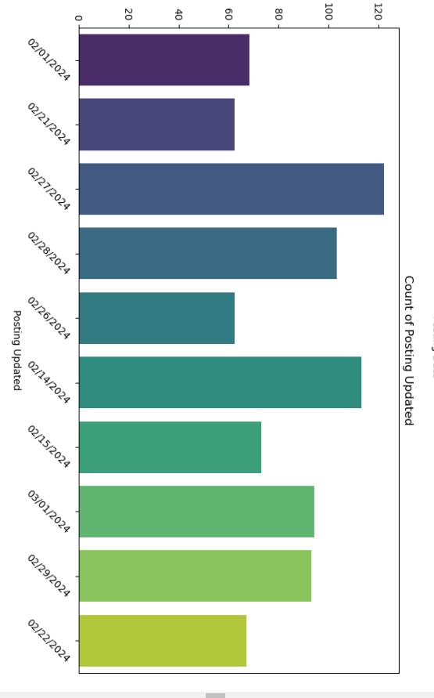
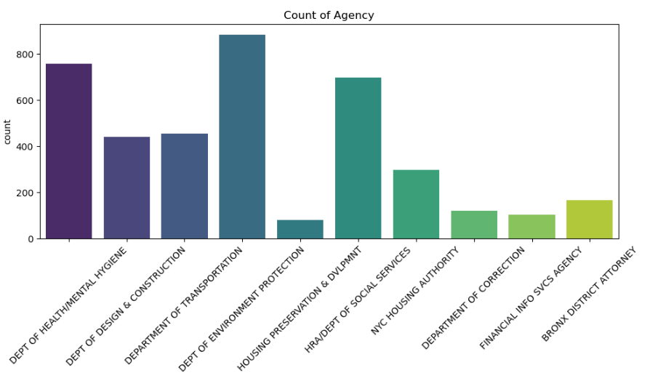
DISTRIBUTION OF CATEGORICAL VARIABLE
To visualize the distribution of the dataset, we can use histograms.
Categorical Variables
For categorical variables such as Job Category, Agency, and others, bar plots or frequency tables are typically used to visualize their distribution across the dataset.
These visualizations provide insights into how data points are distributed across different attributes within the dataset, aiding in understanding the overall characteristics and patterns present.

Slide 8
PREPROCESSSING
Irrelevant Feature Removal:.In my data set , there are ire Valant Features which have to remove .these are suit for features variables .by droping the these columns help to clean the data.
Missing Value Treatment: YES , they are so many missing value found in the dataset. Which is remove by dropna function.
Outliers Treatment :Box-Cox Transformation
After identifying outliers using box plots and the IQR method, I opted for a Box-Cox transformation. This approach stabilizes variance, promotes normal distribution, and preserves dataset integrity for accurate modeling.
Categorical Feature Encoding: Applied one hot encoding to the columns. Each category is represented as a binary vector where only one bit is '1' (hot) while all others are '0' (cold).
Feature Scaling: Are imp. for the algorithms that are sensitive to the magnitude and scale of feature, but not all algorithms requires scaling like Decision Tree are scale-invariant and given our intent to use mix-model we’ve chosen to handle scaling later using pipelines.

Slide 9

TRAIN AND TEST SPLIT
TRAIN TEST SPLIT We divided the data into training (80%) and testing (20%) sets.
Setting a random state ensures consistent results and using stratify=y maintains a proportional distribution of the target variable in both sets.
SPLITING THE DATA INTO X & Y
We divided the dataset into two parts: X and y.
"X" typically represents the independent Variables, and "y" represents the Dependent (target variable) that we want to predict or understand.

Slide 10
MODEL SELECTION
Linear Regression: This model assumes a linear relationship between input features (like job category, experience level) and salary. It's straightforward and interpretable but assumes linearity which may limit accuracy if relationships are more complex.
Decision Tree Regression: This model breaks down the dataset into smaller subsets while recursively applying a decision tree. It can capture nonlinear relationships and interactions between features, making it flexible for complex data patterns.
Random Forest Regression: Built on decision trees, random forest creates multiple trees and aggregates their predictions to improve accuracy and reduce overfitting. It handles large datasets well and provides feature importance insights.
Gradient Boosting: This ensemble technique builds models sequentially, each correcting errors of its predecessor. Gradient boosting is powerful for predictive accuracy and can handle heterogeneous data, though it may be sensitive to overfitting.

Slide 11

Experiment Chart: Performance Comparison of Regression Models
Model | Train MSE | Train R^2 | Test MSE | Test R^2 | Best Parameters
Linear Regression | 1.211e-19 | 1.0 | 1.499e+08 | 0.8873 | N/A
Decision Tree Regression | 4.939e-29 | 1.0 | 1.007e+05 | 0.9999 | {'max_depth': None, 'min_samples_split': 2}
Random Forest Regression | 96301.09 | 0.9999 | 3.517e+05 | 0.9997 | {'max_depth': None, 'n_estimators': 100}
Gradient Boosting | 349066.61 | 0.9997 | 4.255e+05 | 0.9997 | {'learning_rate': 0.1, 'n_estimators': 200}
Observations:
Decision Tree Regression appears to have the best performance based on the test set MSE and R-squared, suggesting it captures complex relationships in the data.
Gradient Boosting and Random Forest also perform well, balancing between model complexity and generalization.

Slide 12

Conclusion
Decision Tree Regression shows exceptional performance with near-perfect fit on both training and test datasets, making it the top-performing model.
Random Forest and Gradient Boosting also perform well, balancing between complexity and generalization.
Linear Regression achieved perfect training fit but struggled with test set performance, indicating limitations in capturing complex relationships.
Recommendation: Implement Decision Tree Regression for its strong predictive capabilities, with further tuning of hyperparameters for optimization. Consider ensemble methods for robustness, and continue refining models with additional data and techniques for improved accuracy.

Slide 13
Thank You!

